Slide 1
Graph Theory
Design and Analysis of Algorithms

Slide 2
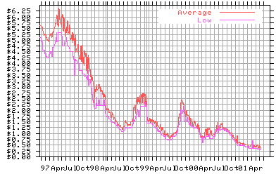
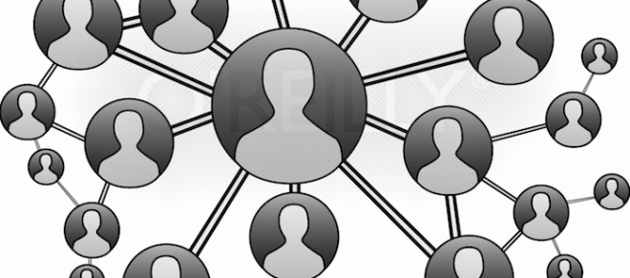
What is a graph?
56
Tokyo
Seattle
Seoul
128
16
181
New York
30
140
L.A.
Sydney

Slide 3
Graphs
graph: A data structure containing:
a set of vertices V, (sometimes called nodes)
a set of edges E, where an edge represents a connection between 2 vertices.
Graph G = (V, E)
an edge is a pair (v, w) where v, w are in V
the graph at right:
V = {a, b, c, d}
E = {(a, c), (b, c), (b, d), (c, d)}
degree: number of edges touching a given vertex.
at right: a=1, b=2, c=3, d=2
a
b
c
d

Slide 4
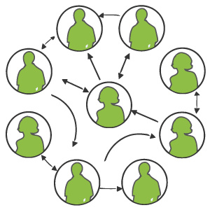
Graph examples
For each, what are the vertices and what are the edges?
Web pages with links
Network broadcast routing
Web crawling
Methods in a program that call each other
Road maps (e.g., Google maps)
Airline routes
Facebook friends
Course pre-requisites
Family trees
Paths through a maze
Solving puzzles and games

Slide 5
Applications of Graphs
Driving Map
Edge = Road
Vertex = Intersection
Edge weight = Time required to cover the road
Airline Traffic
Vertex = Cities serviced by the airline
Edge = Flight exists between two cities
Edge weight = Flight time or flight cost or both
Computer networks
Vertex = Server nodes
Edge = Data link
Edge weight = Connection speed
CAD/VLSI

Slide 6
Paths
path: A path from vertex a to b is a sequence of edges that can be followed starting from a to reach b.
can be represented as vertices visited, or edges taken
example, one path from V to Z: {b, h} or {V, X, Z}
What are two paths from U to Y?
path length: Number of vertices or edges contained in the path.
neighbor or adjacent: Two vertices connected directly by an edge.
example: V and X
V
a
b
U
d
X
Z
h
c
e
W
g
f
Y

Slide 7
Reachability, connectedness
reachable: Vertex a is reachable from b if a path exists from a to b.
connected: A graph is connected if every vertex is reachable from any other.
Is the graph at top right connected?
strongly connected: When every vertex has an edge to every other vertex.
V
a
b
U
d
X
Z
h
c
e
W
g
f
Y
a
b
a
b
d
c
e
c
d

Slide 8
Loops and cycles
cycle: A path that begins and ends at the same node.
example: {b, g, f, c, a} or {V, X, Y, W, U, V}.
example: {c, d, a} or {U, W, V, U}.
acyclic graph: One that does not contain any cycles.
loop: An edge directly from a node to itself.
Many graphs don't allow loops.
V
a
b
U
d
X
Z
h
c
e
W
g
f
Y
Notes:
Simple graphs don't allow loops. A simple graph is an unweighted, undirected graph that doesn't permit multiple edges between the same pair of vertices or loops (an edge directly from a node to itself).

Slide 9
Weighted graphs
weight: Cost associated with a given edge.
Some graphs have weighted edges, and some are unweighted.
Edges in an unweighted graph can be thought of as having equal weight (e.g. all 0, or all 1, etc.)
Most graphs do not allow negative weights.
example: graph of airline flights, weighted by miles between cities:
849
PVD
1843
ORD
SFO
142
802
LGA
1743
337
1387
HNL
2555
1099
LAX
1233
DFW
1120
MIA

Slide 10
Directed graphs
directed graph ("digraph"): One where edges are one-way connections between vertices.
If graph is directed, a vertex has a separate in/out degree.
A digraph can be weighted or unweighted.
Is the graph below connected? Why or why not?
a
b
c
d
e
f
g

Slide 11
Digraph example
Vertices = University courses (incomplete list)
Edge (a, b) = a is a prerequisite for b
120
131
142
140
450
143
154
331
311
341
351
373
374
332
403
312
344
333
352
410
413
414
431
446
444
421
440
451
415
417
452

Slide 12
Linked Lists, Trees, Graphs
A binary tree is a graph with some restrictions:
The tree is an unweighted, directed, acyclic graph (DAG).
Each node's in-degree is at most 1, and out-degree is at most 2.
There is exactly one path from the root to every node.
A linked list is also a graph:
Unweighted DAG.
In/out degree of at most 1 for all nodes.
F
B
K
A
B
C
D
A
E
H
G
J

Slide 13
Searching for paths
Searching for a path from one vertex to another:
Sometimes, we just want any path (or want to know there is a path).
Sometimes, we want to minimize path length (# of edges).
Sometimes, we want to minimize path cost (sum of edge weights).
What is the shortest path from MIA to SFO? Which path has the minimum cost?
$50
PVD
$70
ORD
SFO
$200
$130
$170
$80
LGA
$60
$140
HNL
$250
LAX
$120
$100
DFW
$110
MIA
$500

Slide 14
Graphs
Definition. A directed graph (digraph)
G = (V, E) is an ordered pair consisting of
a set V of vertices (singular: vertex),
a set E ⊆ V × V of edges.
In an undirected graph G = (V, E), the edge set E consists of unordered pairs of vertices.
In either case, we have | E | = O(V ²). Moreover, if G is connected, then | E | ≥ | V | – 1, which implies that lg | E | = Θ(lg V).
(Review CLRS, Appendix B.)
L16.2
Notes:
If the graph is connected (meaning there's a path between any two points), then the number of edges is at least one less than the number of vertices (|E| ≥ |V| - 1).
This implies that the logarithm (base 2) of the number of edges is approximately proportional to the logarithm of the number of vertices (lg |E| = Θ(lg V)).

Slide 15
Adjacency-matrix representation
The adjacency matrix of a graph G = (V, E), where V = {1, 2, …, n}, is the matrix A[1 . . n, 1 . . n] given by
1 if (i, j) ∈ E,
A[i, j] =
0 if (i, j) ∉ E.
L16.3

Slide 16





Adjacency-matrix representation
The adjacency matrix of a graph G = (V, E), where V = {1, 2, …, n}, is the matrix A[1 . . n, 1 . . n] given by
1 if (i, j) ∈ E,
A[i, j] =
0 if (i, j) ∉ E.
A |  |  | 1 | 2 | 3 | 4
2 | 1 | 1 | 0 | 1 | 1 | 0
 |  | 2 | 0 | 0 | 1 | 0
3 | 4 | 3 | 0 | 0 | 0 | 0
 |  | 4 | 0 | 0 | 1 | 0
Θ(V ²) storage
⇒ dense
representation.
L16.4

Slide 17


Adjacency-list representation
An adjacency list of a vertex v ∈ V is the list Adj[v] of vertices adjacent to v.
2 1
3 4
Adj[1] = {2, 3}
Adj[2] = {3}
Adj[3] = {}
Adj[4] = {3}
L16.5

Slide 18
Adjacency-list representation
An adjacency list of a vertex v ∈ V is the list Adj[v] of vertices adjacent to v.
2 1
3 4
Adj[1] = {2, 3}
Adj[2] = {3}
Adj[3] = {}
Adj[4] = {3}
For undirected graphs, | Adj[v] | = degree(v). For digraphs, | Adj[v] | = out-degree(v).
L16.6

Slide 19
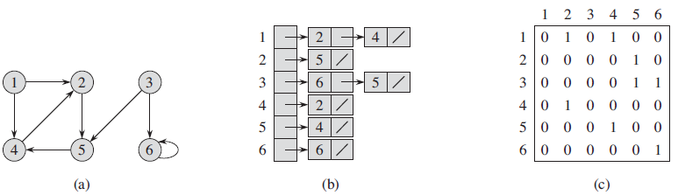
Adjacency-list-Matrix -Example

Slide 20
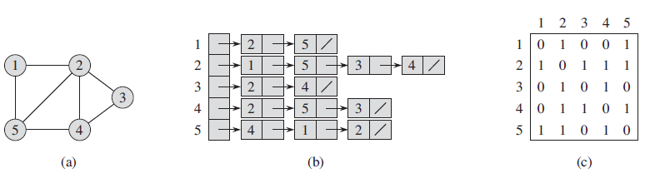
Adjacency-list-Matrix -Example

Slide 21
Adjacency-list representation
An adjacency list of a vertex v ∈ V is the list Adj[v] of vertices adjacent to v.
2 1
3 4
Adj[1] = {2, 3}
Adj[2] = {3}
Adj[3] = {}
Adj[4] = {3}
For undirected graphs, | Adj[v] | = degree(v). For digraphs, | Adj[v] | = out-degree(v).
Handshaking Lemma: ∑_{v∈V} degree(v) = 2 | E | for undirected graphs ⇒ adjacency lists use Θ(V + E) storage — a sparse representation.
L16.7
Notes:
Handshaking Lemma:
For every undirected graph, the sum of the degrees of all vertices is equal to twice the number of edges. Mathematically, ∑(degree(v)) for all vertices v in V = 2|E|.
It's like saying if you count the number of handshakes (connections) each person (vertex) has in a group (graph), the total count is twice the total number of handshakes.
Adjacency Lists and Storage:
When representing an undirected graph using adjacency lists, where each vertex keeps a list of its neighboring vertices, the storage needed is proportional to the sum of the number of vertices (V) and the number of edges (E).
The notation Θ(V + E) is used to express this relationship. It means that the storage required is roughly proportional to the sum of the number of vertices and edges.
Sparse Representation:
The mention of "sparse representation" suggests that this storage approach is particularly efficient when the graph is sparse, meaning it doesn't have too many edges compared to the number of possible edges.

Slide 22
Application of Graphs
Using a model to solve a complicated traffic light problem
GIVEN: A complex intersection.
OBJECTIVE: Traffic light with minimum phases.
SOLUTION:
Identify permitted turns, going straight is a “turn”.
Make group of permitted turns.
Make the smallest possible number of groups.
Assign each phase of the traffic light to a group.

Slide 23
Using a model to solve a complicated traffic light problem
D
E
C
B
A
An intersection

Slide 24
Using a model to solve a complicated traffic light problem
Roads C and E are one way, others are two way.
There are 13 permitted turns.
Some turns such as AB (from A to B) and EC can be carried out simultaneously.
Other like AD and EB cross each other and can not be carried out simultaneously.
The traffic light should permit AB and EC simultaneously, but should not allow AD and EB.

Slide 25
Using a model to solve a complicated traffic light problem
D
AB & AC
E
C
AD & EB
B
A
An intersection

Slide 26
Using a model to solve a complicated traffic light problem
SOLUTION:
We model the problem using a structure called graph G(V,E).
A graph consists of a set of points called vertices, and lines connecting the points, called edges.
Drawing a graph such that the vertices represent turns.
Edges between those turns that can NOT be performed simultaneously.

Slide 27
Using a model to solve a complicated traffic light problem
D
E
AB
AC
AD
C
BA
BC
BD
B
DA
DB
DC
A
An intersection
EA
EB
EC
ED
Partial graph of incompatible turns

Slide 28
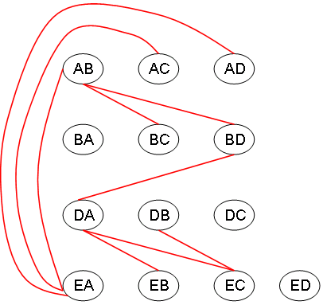
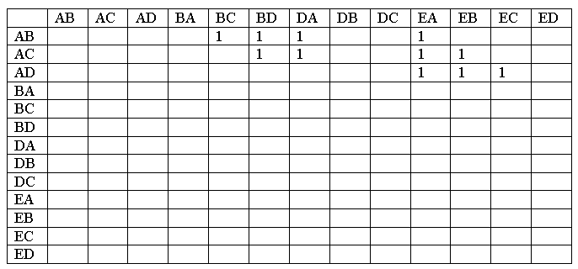
Using a model to solve a complicated traffic light problem
Partial table of incompatible turns

Slide 29
Using a model to solve a complicated traffic light problem
SOLUTION:
The graph can aid in solving our problem.
A coloring of a graph is an assignment of a color to each vertex of the graph, so that no two vertices connected by an edge have the same color.
Our problem is of coloring the graph of incompatible turns using as few colors as possible.

Slide 30
Using a model to solve a complicated traffic light problem
More on SOLUTION (Graph coloring):
The problem has been studied for decades.
The theory of algorithms tells us a lot about it.
Unfortunately this belongs to a class of problems called as NP-Complete problems.
Notes:
NP stands for "nondeterministic polynomial time." Problems in this class are ones where, if you have a potential solution, you can verify if it's correct or not quickly (in polynomial time). However, finding that solution in the first place might not be quick.
NP-Complete problems are the toughest problems in NP. If you could solve one NP-Complete problem quickly, you could solve all NP problems quickly. However, no one has yet found a quick solution for any NP-Complete problem.
Examples of NP-Complete problems include the Traveling Salesman Problem, where you need to find the shortest route that visits a list of cities and returns to the start, and the Graph Coloring Problem, where you try to color a graph's vertices with the minimum number of colors without two adjacent vertices sharing the same color.

Slide 31
Using a model to solve a complicated traffic light problem
An algorithm that quickly produces good but not necessarily optimal solutions is called a heuristic.

Slide 32
A reasonable heuristic for graph coloring is the greedy algorithm.
Try to color as many vertices as possible with the first color, and then as many uncolored vertices with the second color, and so on.
The approach would be:
Select some uncolored vertex, and color with new color.
Scan the list of uncolored vertices. For each uncolored vertex, determine whether it has an edge to any vertex already colored with the new color. If there is no such edge, color the present vertices with the new color.

Slide 33
This is called “greedy”, because it colors a vertex, whenever it can, without considering potential drawbacks.
3
3
1
1
5
5
2
2
3
3
4
4
1
1
5
5
2
4

Slide 34
Graph Traversals

Slide 35
Depth-first searching
A depth-first search (DFS) explores a path all the way to a leaf before backtracking and exploring another path
For example, after searching A, then B, then D, the search backtracks and tries another path from B
Node are explored in the order A B D E H L M N I O P C F G J K Q
N will be found before J
A
B
C
D
E
F
G
H
I
J
K
L
M
N
O
P
Q

Slide 36
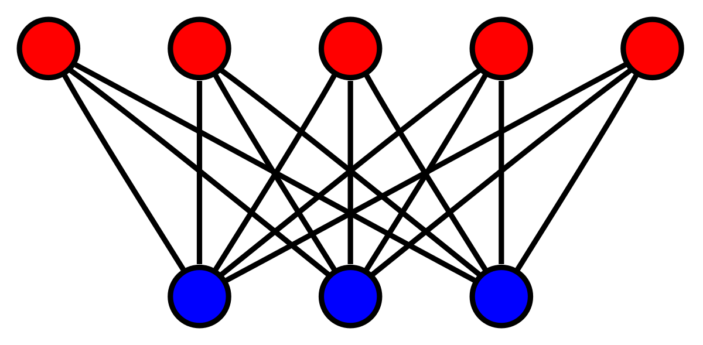
Depth First Search
Depth-first search (DFS) is an algorithm (or technique) for traversing a graph.
Detecting cycle in a graph
Path Finding
Topological Sorting
To test if a graph is bipartite
Finding Strongly Connected Components of a graph
Solving puzzles with only one solution
Bipartite Graph
Notes:
Depth-first search (DFS) is an algorithm (or technique) for traversing a graph.
Following are the problems that use DFS as a building block.
1) For a weighted graph, DFS traversal of the graph produces the minimum spanning tree and all pair shortest path tree.
2) Detecting cycle in a graph A graph has cycle if and only if we see a back edge during DFS. So we can run DFS for the graph and check for back edges. (See this for details)
3) Path Finding We can specialize the DFS algorithm to find a path between two given vertices u and z. i) Call DFS(G, u) with u as the start vertex. ii) Use a stack S to keep track of the path between the start vertex and the current vertex. iii) As soon as destination vertex z is encountered, return the path as the contents of the stack
4) Topological Sorting Topological Sorting is mainly used for scheduling jobs from the given dependencies among jobs. In computer science, applications of this type arise in instruction scheduling, ordering of formula cell evaluation when recomputing formula values in spreadsheets, logic synthesis, determining the order of compilation tasks to perform in makefiles, data serialization, and resolving symbol dependencies in linkers [2].
5) To test if a graph is bipartite We can augment either BFS or DFS when we first discover a new vertex, color it opposited its parents, and for each other edge, check it doesn’t link two vertices of the same color. The first vertex in any connected component can be red or black! See this for details.
6) Finding Strongly Connected Components of a graph A directed graph is called strongly connected if there is a path from each vertex in the graph to every other vertex. (See this for DFS based algo for finding Strongly Connected Components) 7) Solving puzzles with only one solution, such as mazes. (DFS can be adapted to find all solutions to a maze by only including nodes on the current path in the visited set.)

Slide 37
Breadth-first searching
A breadth-first search (BFS) explores nodes nearest the root before exploring nodes further away
For example, after searching A, then B, then C, the search proceeds with D, E, F, G
Node are explored in the order A B C D E F G H I J K L M N O P Q
J will be found before N
A
B
C
D
E
F
G
H
I
J
K
L
M
N
O
P
Q

Slide 38
Breadth-first search
Breadth-first search is one of the simplest algorithms for searching a graph and the archetype for many important graph algorithms.
Given a graph G = (V, E) and a distinguished source vertex s, breadth-first search systematically explores the edges of G to “discover” every vertex that is reachable from s.
It computes the distance (smallest number of edges) from s to each reachable vertex.
It also produces a “breadth-first tree” with root s that contains all reachable vertices.
For any vertex reachable from s, the simple path in the breadth-first tree from s to corresponds to a “shortest path” from s to in G, that is, a path containing the smallest number of edges.
The algorithm works on both directed and undirected graphs.

Slide 39
Breadth-first searching
Shortest Path and Minimum Spanning Tree for unweighted graph
Peer to Peer Networks
Crawlers in Search Engines
Social Networking Websites
GPS Navigation systems: Breadth First Search is used to find all neighboring locations.
Broadcasting in Network: In networks, a broadcasted packet follows Breadth First Search to reach all nodes.
In Garbage Collection
Cycle detection in undirected graph:
Notes:
1) Shortest Path and Minimum Spanning Tree for unweighted graph In an unweighted graph, the shortest path is the path with least number of edges. With Breadth First, we always reach a vertex from given source using the minimum number of edges. Also, in case of unweighted graphs, any spanning tree is Minimum Spanning Tree and we can use either Depth or Breadth first traversal for finding a spanning tree.
2) Peer to Peer Networks. In Peer to Peer Networks like BitTorrent, Breadth First Search is used to find all neighbor nodes.
3) Crawlers in Search Engines: Crawlers build index using Breadth First. The idea is to start from source page and follow all links from source and keep doing same. Depth First Traversal can also be used for crawlers, but the advantage with Breadth First Traversal is, depth or levels of the built tree can be limited.
4) Social Networking Websites: In social networks, we can find people within a given distance ‘k’ from a person using Breadth First Search till ‘k’ levels.
5) GPS Navigation systems: Breadth First Search is used to find all neighboring locations.
6) Broadcasting in Network: In networks, a broadcasted packet follows Breadth First Search to reach all nodes.
7) In Garbage Collection: Breadth First Search is used in copying garbage collection using Cheney’s algorithm. Refer this and for details. Breadth First Search is preferred over Depth First Search because of better locality of reference:
8) Cycle detection in undirected graph: In undirected graphs, either Breadth First Search or Depth First Search can be used to detect cycle. We can use BFS to detect cycle in a directed graph also,
9) Ford–Fulkerson algorithm In Ford-Fulkerson algorithm, we can either use Breadth First or Depth First Traversal to find the maximum flow. Breadth First Traversal is preferred as it reduces worst case time complexity to O(VE²).

Slide 40
Breadth-first searching
To test if a graph is Bipartite
Path Finding
Finding all nodes within one connected component.

